Slide 1

Chapter 5
Introduction to
Modern Symmetric-key
Ciphers
5.<number>
Copyright © The McGraw-Hill Companies, Inc. Permission required for reproduction or display.

Slide 2
5-1 MODERN BLOCK CIPHERS
A symmetric-key modern block cipher encrypts an
n-bit block of plaintext or decrypts an n-bit block of ciphertext. The encryption or decryption algorithm uses a k-bit key.
5.<number>

Slide 3
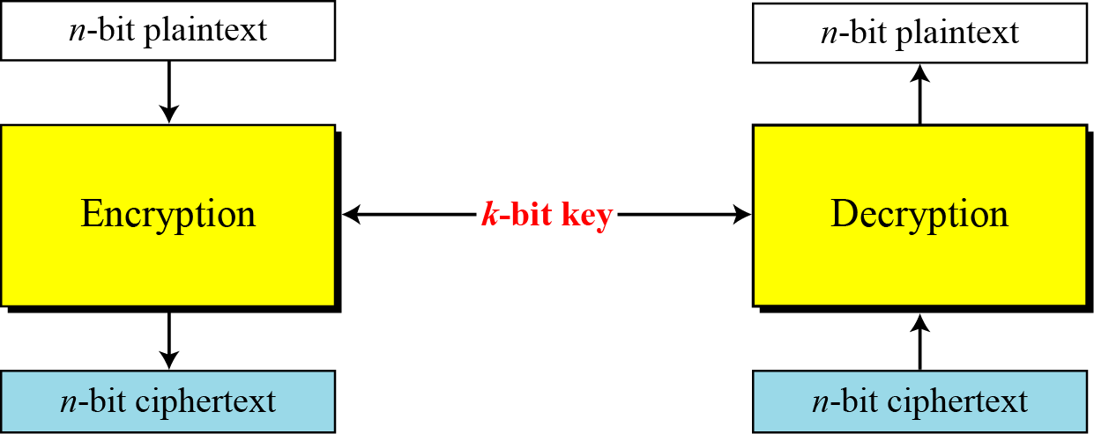
5.1 Continued
Figure 5.1 A modern block cipher
5.<number>

Slide 4
5.1.3 Components of a Modern Block Cipher
Modern block ciphers normally are keyed substitution ciphers in which the key allows only partial mappings from the possible inputs to the possible outputs.
P-Boxes
A P-box (permutation box) parallels the traditional transposition cipher for characters. It transposes bits.
5.<number>

Slide 5
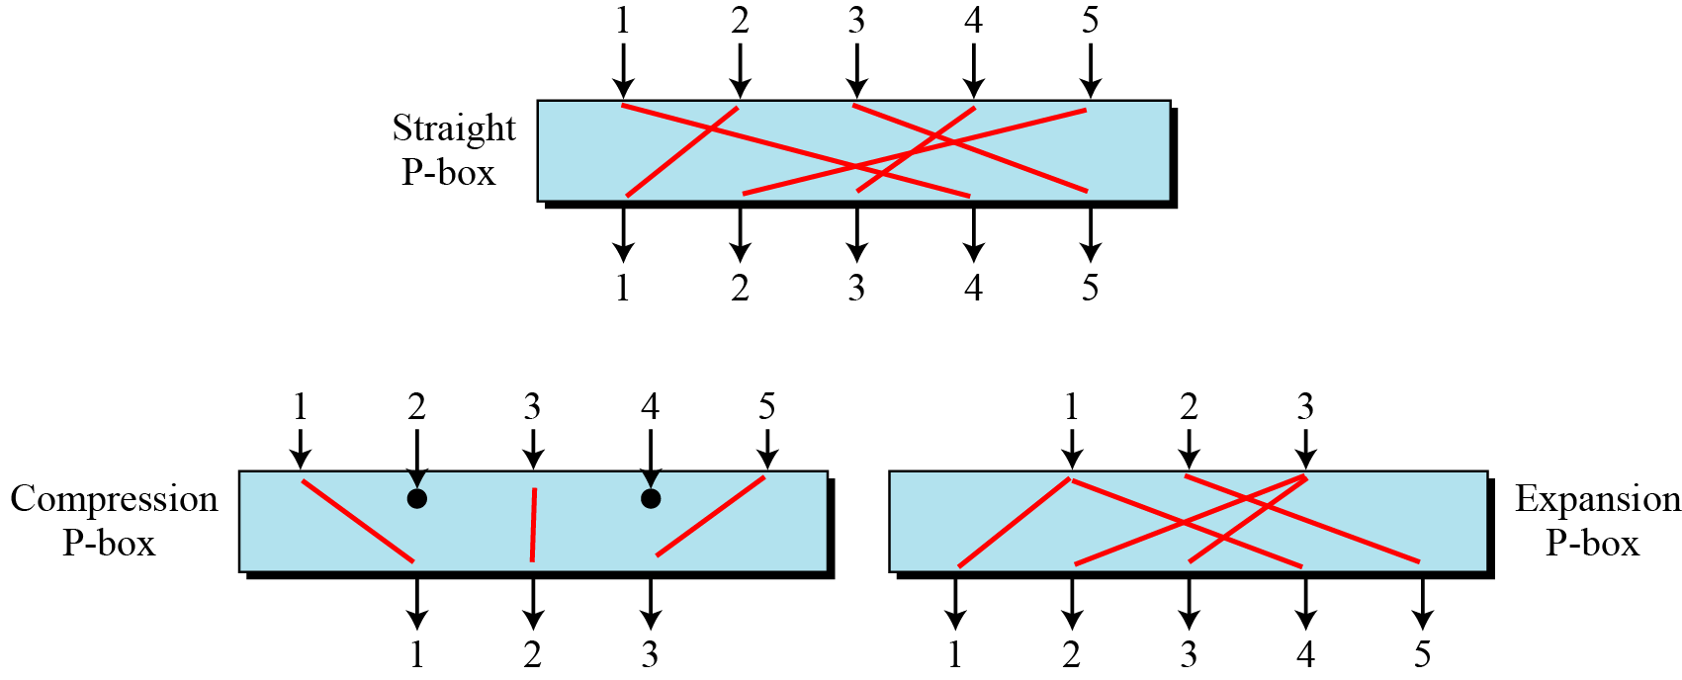
5.1.3 Continued
Figure 5.4 Three types of P-boxes
5.<number>

Slide 6

5.1.3 Continued
S-Box
An S-box (substitution box) can be thought of as a miniature substitution cipher.
Note
An S-box is an m × n substitution unit, where m and n are not necessarily the same.
5.<number>

Slide 7
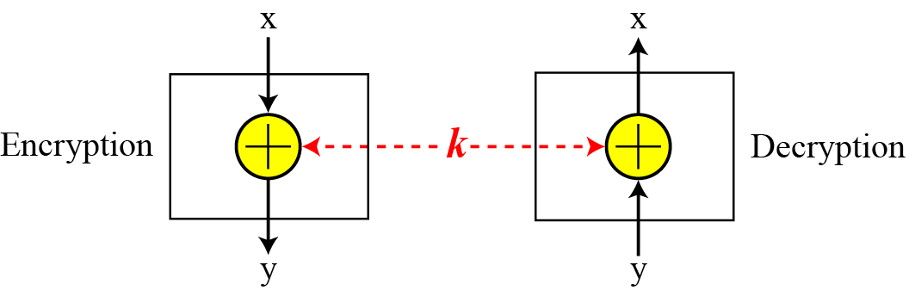
5.1.3 Continued
Exclusive-Or
An important component in most block ciphers is the exclusive-or operation.
Figure 5.9 Invertibility of the exclusive-or operation
5.<number>

Slide 8
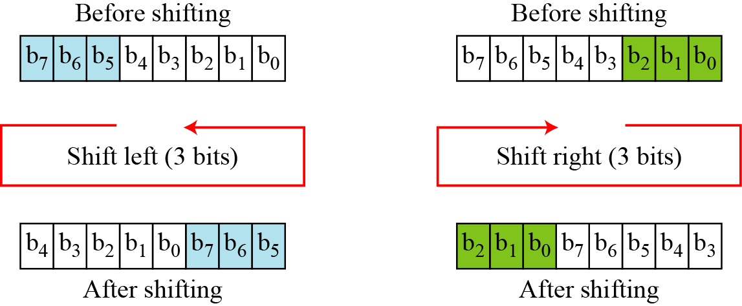
5.1.3 Continued
Circular Shift
Another component found in some modern block ciphers is the circular shift operation.
Figure 5.10 Circular shifting an 8-bit word to the left or right
5.<number>

Slide 9
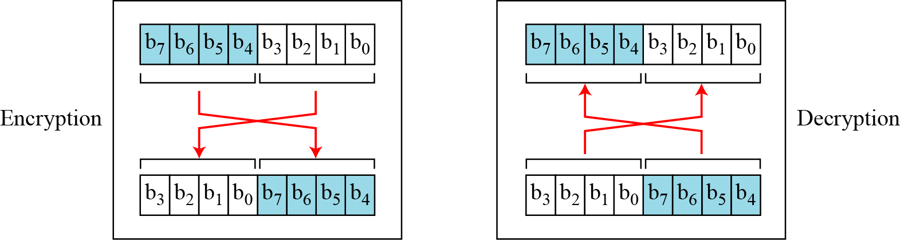
5.1.3 Continued
Swap
The swap operation is a special case of the circular shift operation where k = n/2.
Figure 5.11 Swap operation on an 8-bit word
5.<number>

Slide 10
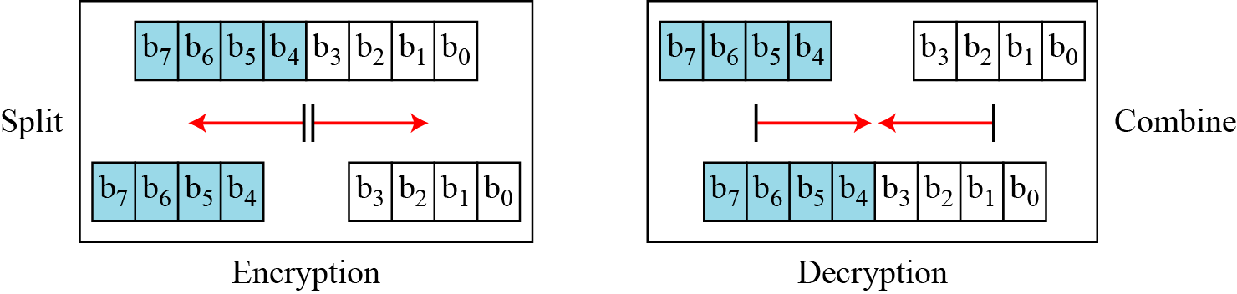
5.1.3 Continued
Split and Combine
Two other operations found in some block ciphers are split and combine.
Figure 5.12 Split and combine operations on an 8-bit word
5.<number>

Slide 11
6-1 INTRODUCTION
The Data Encryption Standard (DES) is a symmetric-key block cipher published by the National Institute of Standards and Technology (NIST).
6.<number>

Slide 12

6.1.2 Overview
DES is a block cipher, as shown in Figure 6.1.
Figure 6.1 Encryption and decryption with DES
6.<number>

Slide 13

6-2 Continue
Figure 6.2 General structure of DES
6.<number>

